Slide 1
CNA Instructor
Quick-Start Guide
CNA Instructor Quick-Start Guide:
A comprehensive resource guide designed to support new instructors in
delivering effective teaching.
Vol. 1
Designed to support new instructors in delivering effective teaching.
Notes:
Created from: https://outlook.office.com/mail/

Slide 2
Disclaimer
By providing links to other sites Southern Illinois University Nurse Aide Testing (SIUC NAT) and the Illinois Department of Public Health (IDPH) do not guarantee, approve, or endorse the information or products available on these sites.

Slide 3
Topic 1
Familiarize Yourself with IDPH Requirements
This section provides essential information on the Illinois Department of Public Health (IDPH) guidelines to help ensure that your program stays compliant and meets all necessary standards within the classroom and program environment.
Notes:
Image from: https://onlinenursing.duq.edu/blog/nurse-educator-role/

Slide 4
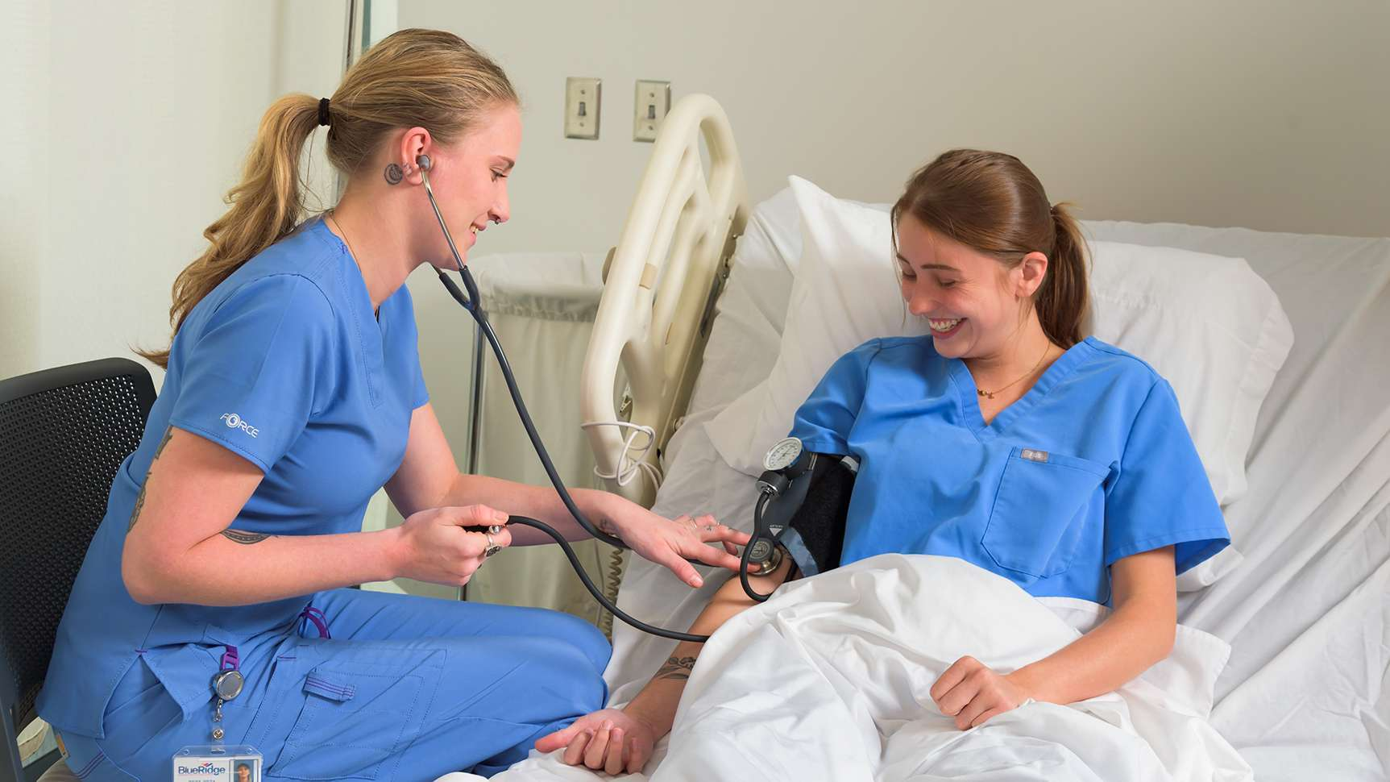
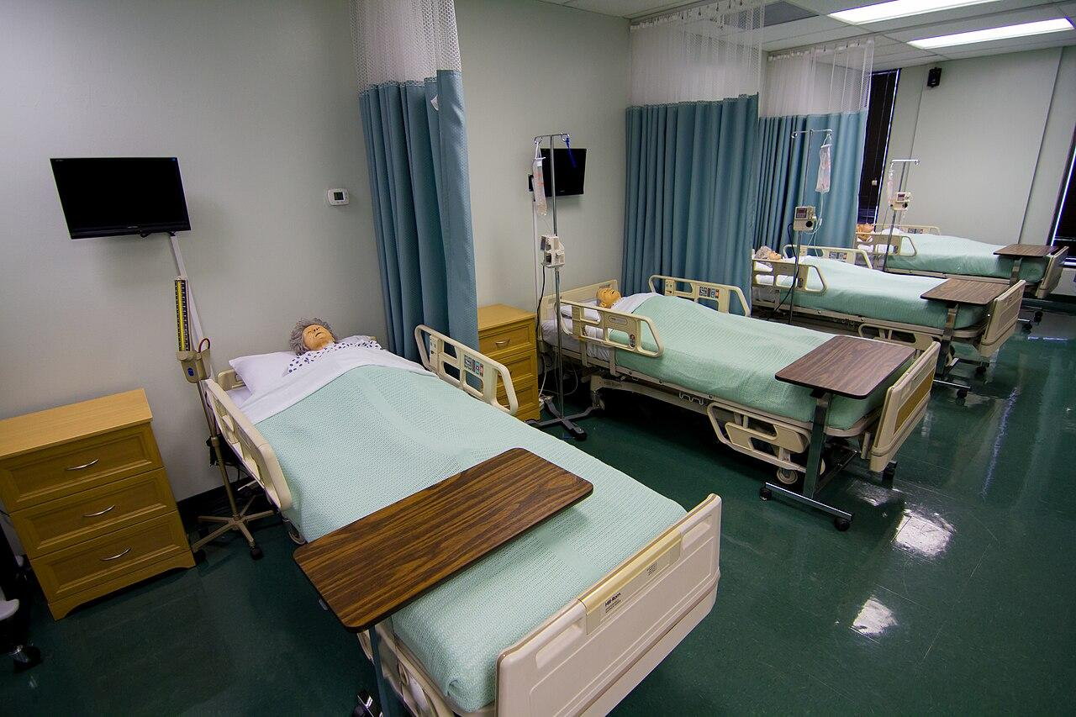
IDPH Requirements Overview
Program Operation (Section 395.170)
Student-to-Instructor Ratios
Lab: 16:1
Clinical: 8:1
Lab Bed Assignments: 5 students per bed
Skill Competency
Students must demonstrate competency in all Department-approved skills through hands-on return demonstrations evaluated by an approved instructor.
Minimum Hours of Instruction (Section 395.150)
Theory: 80 hours (includes 16 lab hours, 12 AD content hours, and 4 CPR hours*)
Clinical: 40 hours
(*CPR hours may be deducted if covered elsewhere.)
Classroom & Laboratory Requirements
Clean and equipped with functioning tools
Free of pests and excessive litter
No food or drink permitted
Supplies must be clean, available, and ready for use

Slide 5
Topic 2
How IDPH Monitors Program Compliance: Monitoring Visit Key Points
This chapter offers crucial information to help you prepare for an unannounced monitoring visit, aiming to reduce stress and anxiety. By understanding the requirements and expectations, you can approach the visit confidently. Effective preparation is essential for a smooth monitoring experience.

Slide 6
Master Schedule Compliance
Follow the schedule; report changes immediately to the PC.
PC must notify IDPH via email: dph.bnatp@illinois.gov.
Visit Planning
Education Coordinators use the Master Schedule for visit planning.
Visits occur every 2 years and are unannounced.
Additional Resources
How to Prepare for a Monitoring Visit (Video)
Monitoring Visit Evaluation Form
Monitoring Visit Document Requirements

Slide 7
Topic 3
Lesson Planning Essentials
This chapter helps you create effective lesson plans and a comprehensive syllabus, detailing objectives, content, and activities for each class while fostering a positive learning environment that supports student success.
Notes:
Image from: https://www.freepik.com/premium-ai-image/school-curriculum-planning-with-teachers-reviewing-educational-materials-organized-setting-sharp-focus-bright-lighting_357887302.htm

Slide 8
Developing Effective Lesson Plans (Section 395.300)
Syllabus Importance & Key Components
A syllabus provides structure, sets expectations, and keeps students and instructors on track.
What to Include:
Course Info: Title, instructor, contact, schedule.
Description: Course overview and objectives.
Learning Outcomes: Expected skills/knowledge.
Materials: Required textbooks/resources.
Schedule: Topics, readings, deadlines.
Grading: Assessment breakdown and scale.
Policies: Attendance, participation, and conduct.
Support: Academic resources.
Accommodations: Disability support.
Strategies for Effective Lesson Planning
Align lessons with curriculum requirements.- Set clear goals and objectives
Utilize engaging teaching methods and materials.
Use a learning management system for better organization.
Regularly review and update your schedule.
For additional guidance, refer to the provided link on lesson planning.

Slide 9
Topic 4
Building a Conducive Classroom & Learning Environment
To create a productive learning environment, it is essential to set clear expectations, encourage student engagement, and offer continuous support. This section highlights important strategies for establishing a positive classroom atmosphere, increasing student participation, and ensuring that all students—especially those who may be facing challenges—have the necessary resources to succeed.

Slide 10
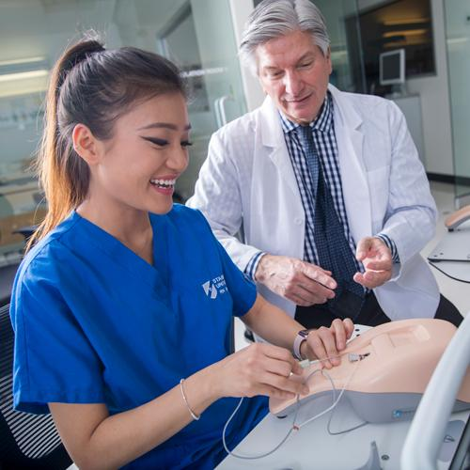
Engaging Teaching Strategies
Effective Classroom Practices
Set clear expectations & procedures (Guide)
Build rapport by getting to know students (Guide)
Provide & receive feedback promptly (Guide)
Encourage participation & engagement (Guide)
Identify & support struggling students early
Foster respect & a positive learning environment
Use mistakes as learning opportunities
Leverage technology to enhance learning
Review syllabus & have students sign a statement of understanding
Notes:
Image from: https://blog.stanbridge.edu/?p=77558

Slide 11
Topic 5
Classroom Activity Ideas
To enhance student engagement and deepen understanding, incorporating interactive activities is essential. This section presents a variety of classroom activity ideas that promote critical thinking, collaboration, and practical application of knowledge.

Slide 12
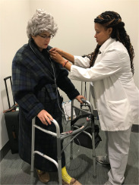
Video Platforms: Use resources like credible videos for engaging educational content.
Think-Pair-Share: Students reflect on a question individually, discuss it with a partner, and then share insights with the class.
Case Studies: Present real-world scenarios for students to analyze and apply key concepts.
Role-Playing & Simulations: Encourage students to step into different perspectives and practice applying knowledge in a realistic setting.
Bell Ringer Activity: A short question or problem is given at the beginning of the class to engage students.
Muddiest Point Activity: An activity that allows the instructor to gather feedback on a concept or part of a lesson that a student found confusing.
Focusing on these foundational areas will help you effectively begin your journey as a CNA instructor. Let me know if you'd like help with lesson planning, resources, or curriculum development!
Notes:
Image from: https://www.cw.edu/programs/school-of-health-professions-aas-medical-assistant-management/

Slide 13
Topic 6
C & C Club
Enhance Your Teaching Through Networking
Join the C & C Club!
Networking with other instructors and programs can provide valuable insight into common challenges, fresh classroom ideas, and strategies for engaging students in difficult subjects. Consider joining the C&C Club to connect, collaborate, and grow together. If you're interested in joining, reach out to Angela Pavlick, Education Coordinator of the Chicago area.

Slide 14
Education Coordinator – Southern Region Beth Young, RN, MSN-Ed, 618-521-0088 Email Address: educoordsouth@siu.edu
Education Coordinator – Chicago Area Angela Pavlick, BSN, RN 618-534-6715 Email Address: educoordchicagoarea@siu.edu
Education Coordinator – Northern Region Tabitha Reeise, RN, MSN-Ed, 618-521-2760 Email Address: educoordnorth@siu.edu

